Slide 1
Radial-Basis Function Networks
(5.13 ~ 5.15)
Huafu Chen
SLST, UESTC

Slide 2
Learning Strategies(1)
Learning process of RBF network
  Hidden layer’s activation function evolve slowly with some nonlinear optimization strategy.
  Output layer’s weight is adjusted rapidly through linear optimization strategy.
  It is reasonable to separate the optimization of the hidden and output layers of the network by using different techniques, and perhaps on different time scales. (Lowe, 1991)

Slide 3
Learning Strategies(2)
Various learning strategies
  Four approaches
  identified by the way how the centers of the radial-basis functions of the network are specified.
  Interpolation theory
    1) Fixed centers selected at random
    2) Self-organized selection of centers
    3) Supervised selection of centers
  Regularization theory + kernel regression estimation theory
    4) Strict interpolation with regularization

Slide 4
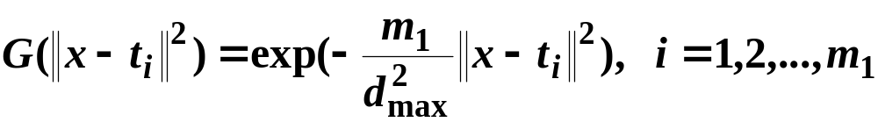


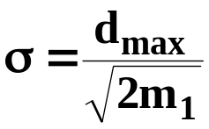
1) Fixed centers selected at random
The locations of the centers may be chosen randomly from the training data set.
A radial basis function
  ; number of centers
  ; maximum distance between the chosen centers
  the standard deviation of the Gaussian function is
We can use different values of centers and widths for each radial basis function.
Notes:
We can use different values of centers and widths for each radial basis function -> experimentation with training data is needed.

Slide 5



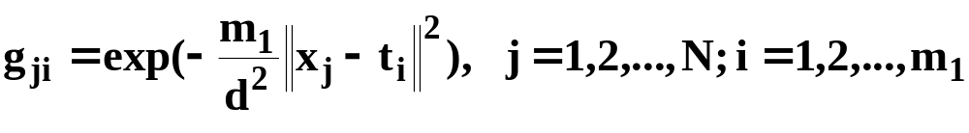


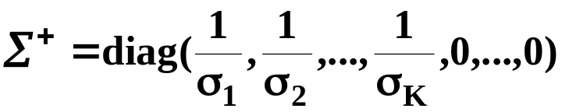

Only output layer weight is need to be learned.
Obtain the value of the output layer weight by pseudo-inverse method;
  where is pseudo-inverse matrix of the matrix
Computation of pseudo-inverse matrix ; SVD decomposition
  if G is a real N-by-M matrix, there exist orthogonal matrices
  and
  such that
  Then, pseudo inverse of matrix G is
  where

Slide 6
2)Self-organized selection of centers
Main problem of the above fixed centers method
  it may require a large training set for a satisfactory level of performance
Hybrid learning
  self-organized learning to estimate the centers of RBFs in hidden layer
  supervised learning to estimate the linear weights of the output layer
Self-organized learning of centers by means of clustering.
Supervised learning of output weights by LMS algorithm.
Notes:
LMS 最小均方算法
self-organized learning to estimate the centers of RBFs in hidden layer: 对训练样本进行自组织聚类，得到一些聚类中心，作为我们的centers

Slide 7
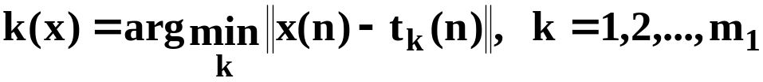
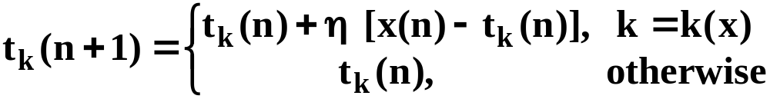

2)Self-organized selection of centers
k-means clustering
  1. Initialization - choose initial centers randomly
  2. Sampling - draw a sample vector x from input space
  3. Similarity matching - k(x) is index of the best matching center for input vector x
  4. Updating -
  5. Continuation - increment n by 1 and go back to step 2
LMS algorithm
The output layer is a linear network,
LMS can be used to update the weight
Notes:
最后一层实际上是一个 single perceptron, 可以有很多方法，也可以用 广义逆方法进行求解

Slide 8
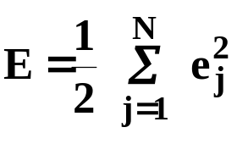
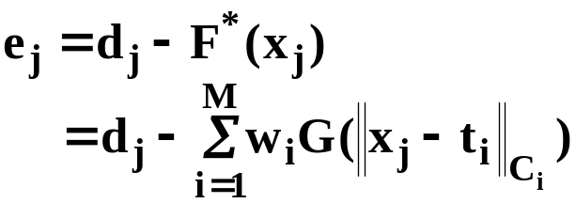
3) Supervised selection of centers
All free parameters of the network are changed by supervised learning process.
Error-correction learning using LMS algorithm.
Cost function ( N –samples of training dataset)
Error-signal

Slide 9
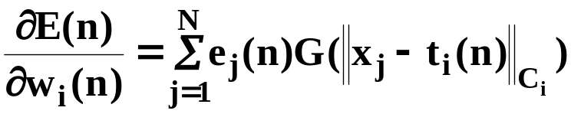
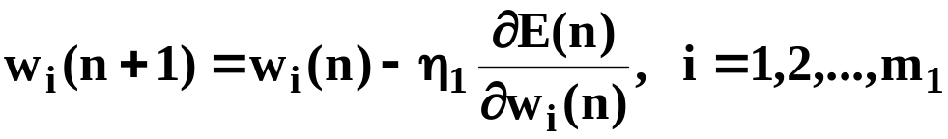
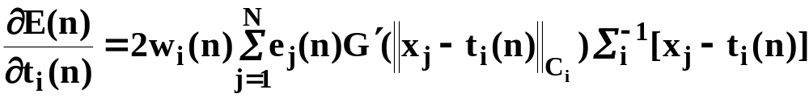
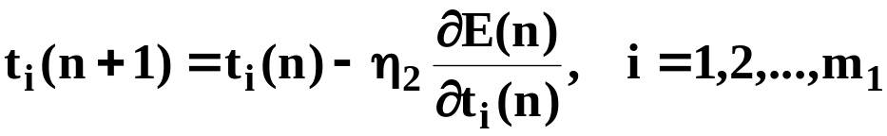
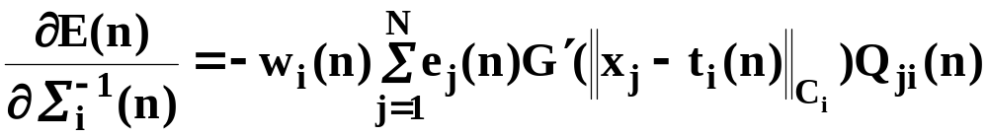
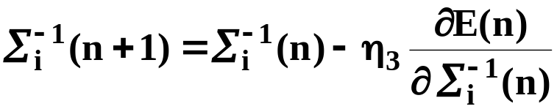

3)Supervised selection of centers
Find the free parameters so as to minimize E.
( Gradient method, table 5.4)
linear weights
position of centers
spreads of centers
Notes:
最后的线性权
中心位置
Gauss 函数的方差

Slide 10





3) Supervised selection of centers
Notable points
  The cost function E is convex w.r.t (with respect to) linear parameter
  is not convex w.r.t and
  -> search may get stuck in a local minimum in parameter space for the later two parameters.
  Different learning-rate parameter for each parameter’s update eqn.
  respectively.
  The gradient-descent procedure in RBF does not involve error back-propagation.
  The gradient vector has an effect similar to a clustering effect that is task-dependent.

Slide 11
3) Supervised selection of centers
Comparing the performance for the NETtalk task ( map English spelling into its phonetic pronunciation) with Multilayer perceptron.
Gaussian raidal-basis function networks with fixed centers;
RBF did not generalize nearly as well as MLP trained by BP.
2) generalized raidal-basis function networks with adjustable centers which were determined by supervised learning;
Generalized RBF were able to exceed substantially the generalization performance of multilayer perceptrons.

Slide 12




4) Strict interpolation with regularization
Combination of elements of the regularization theory and the kernel regression theory.
Four ingredients of this method
  1. RBF G as the kernel of NWRE .
  2. Generalized RBF: Diagonal input norm-weighting matrix
(Eq.(5.81)/Page 281)weighted norm of the Euclidean distance by
  we may set
Is the sample variance of the ith input variable estimated from training data
a scale factor
Notes:
组合应用 4 个方面：
1） 用RBF Green 函数作为NWRE的核函数
2） 对输入进行加权处理 （考虑不同点的差异）
3）（下页） 考虑Tikhonov正则化方案
4） GCV方法选择正则化参数等
NWRE Kernel regression
Nadaraya-Watson regression estimation page 295
该方法包括组合利用以下 4 个部分

Slide 13



4) Strict interpolation with regularization
  3. Regularized strict interpolation which involves linear weight training according to
  4. Selection of the regularization parameter and the input scale factor via an asymptotically optimal method such as the GCV method.

Slide 14

4) Strict interpolation with regularization
Interpretation of parameters
  The larger , the larger is the noise corrupting the measurement of parameters.
  When the radial-basis function G is a unimodal kernel (e.g. Gaussian kernel– Distance ( radial basis function)).
    The smaller the value of a particular ,the more ‘sensitive’ the overall network output is to the associated input dimension.
    We can use the selected to rank the relative significance of the input variables and indicate which input variables are suitable candidate for dimensionality reduction.
Notes:
By synthesizing both the regularization theory and kernel regression estimation theory, practical prescription for theoretically supported regularized RBF network design and application is possible.

Slide 15
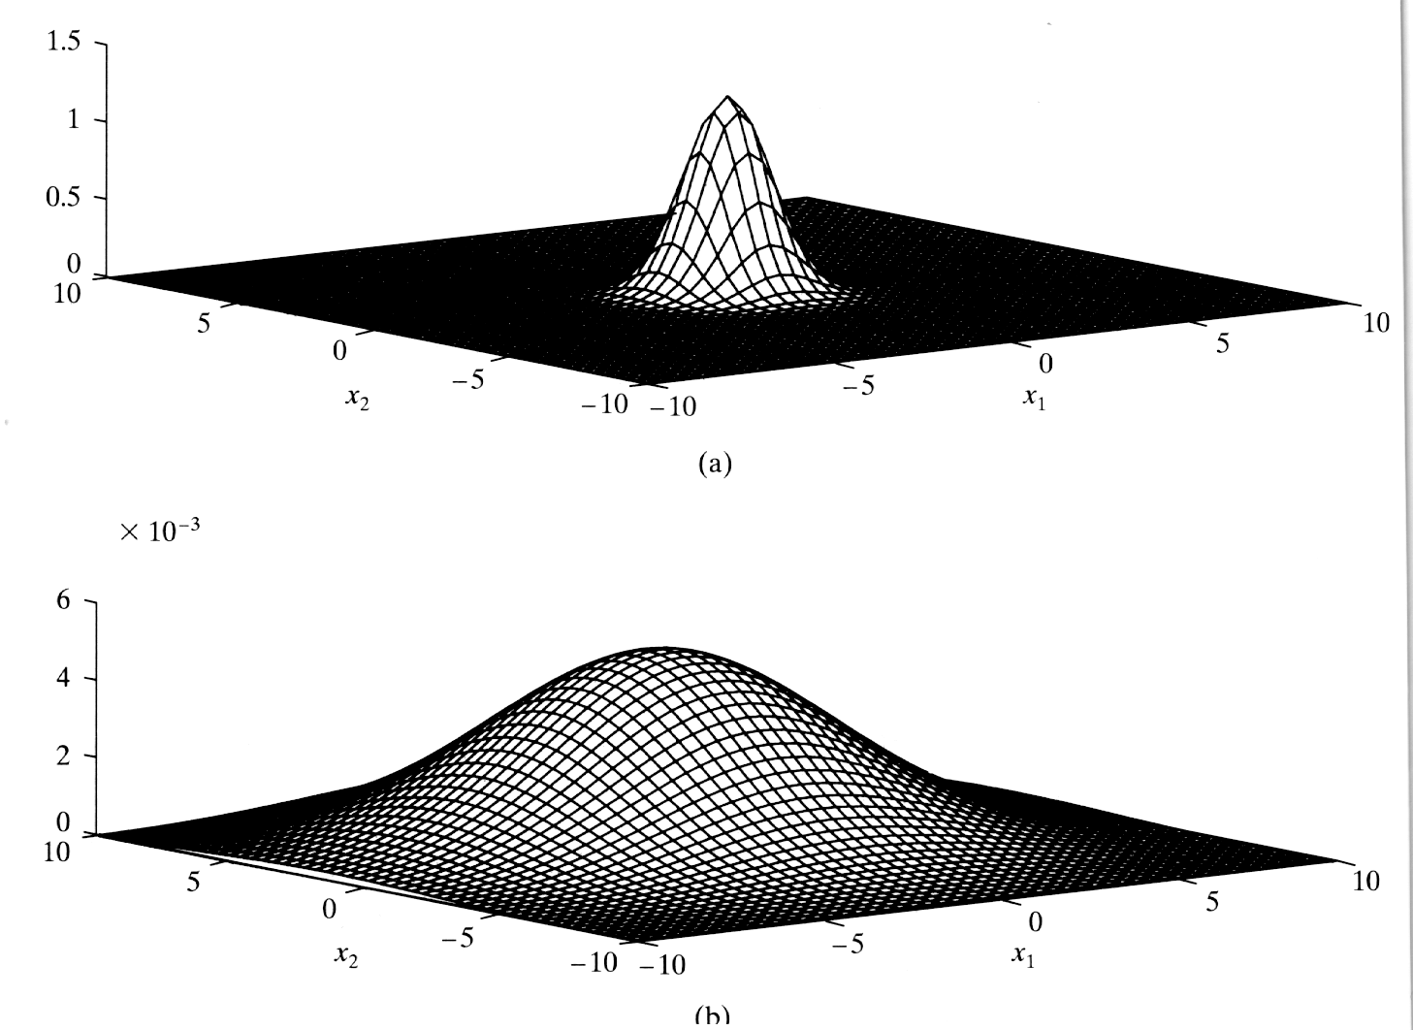
Computer experiment :
Pattern classification
Fig. 4.13 / page 188

Slide 16
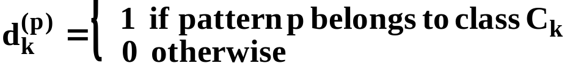
Computer experiment :
Pattern classification
Two output neurons for each class
  desired output value
  decision rule
    select the class corresponding to the maximum output function
  computation of output layer weight
  Two case with various value of parameter
    # of centers = 20
    # of centers = 100
  See Table 5.5 and Table 5.6 at page 306.

Slide 17
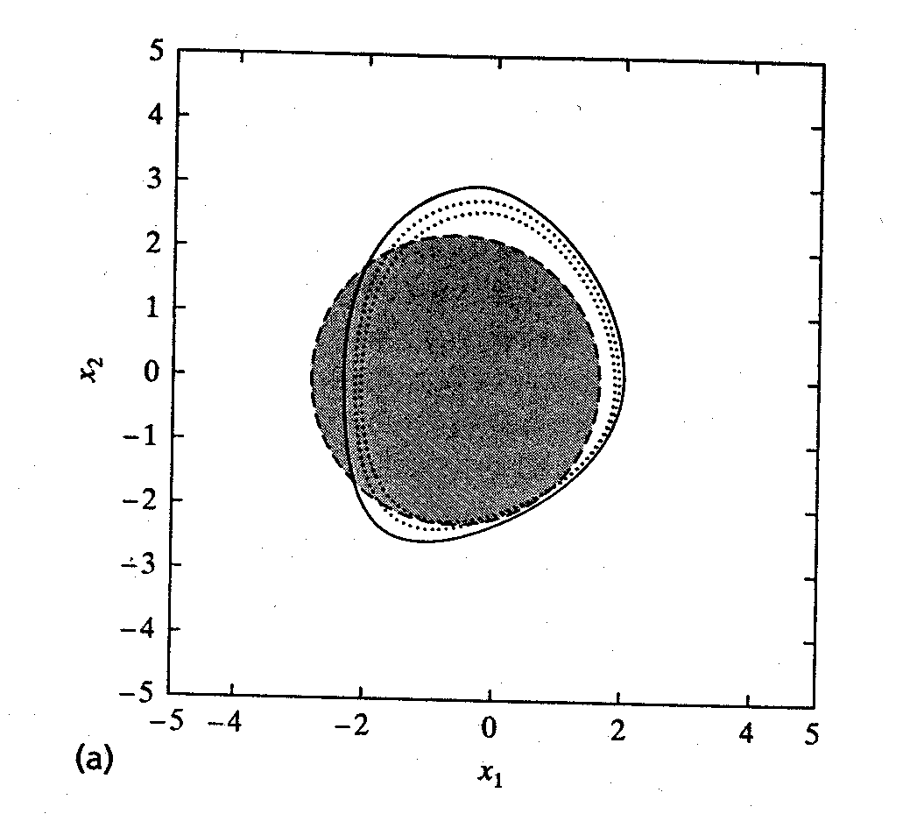
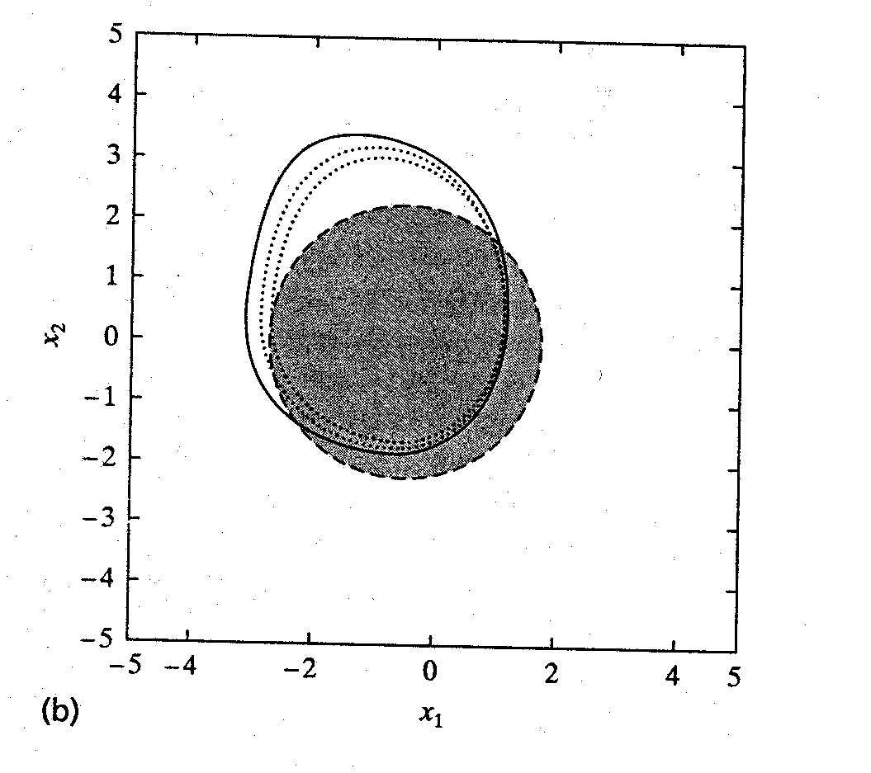
Computer experiment :
Pattern classification
Best solution vs Worst solution

Slide 18


Computer experiment :
Pattern classification
Observations from experimental results.
  1. For both case, the classification performance of the network for is relatively poor.
  2. The use of regularization has a dramatic influence on the classification performance of the RBF network.
  3. For , the classification performance of the network is somewhat insensitive to an increase in the regularization parameter
  4. Increasing the number of centers from 20 to 100 improves the classification performance by about 4.5 percent

Slide 19
Summary and discussion
The structure of RBF network
  hidden units are entirely different from output units.
Design of RBF network
  Tikhonov’s regularization theory.
  Green’s function as the basis function of the networks.
  Smoothing constraint specified by the differential operator D.
  Estimating regularization parameter . <- generalized cross-validation or other regularization techniques.
  Kernel regression.
I/O mapping of a Gaussian RBF networks bears a close resemblance to that realized by a mixture of experts discussed in chap 7.

